Slide 1



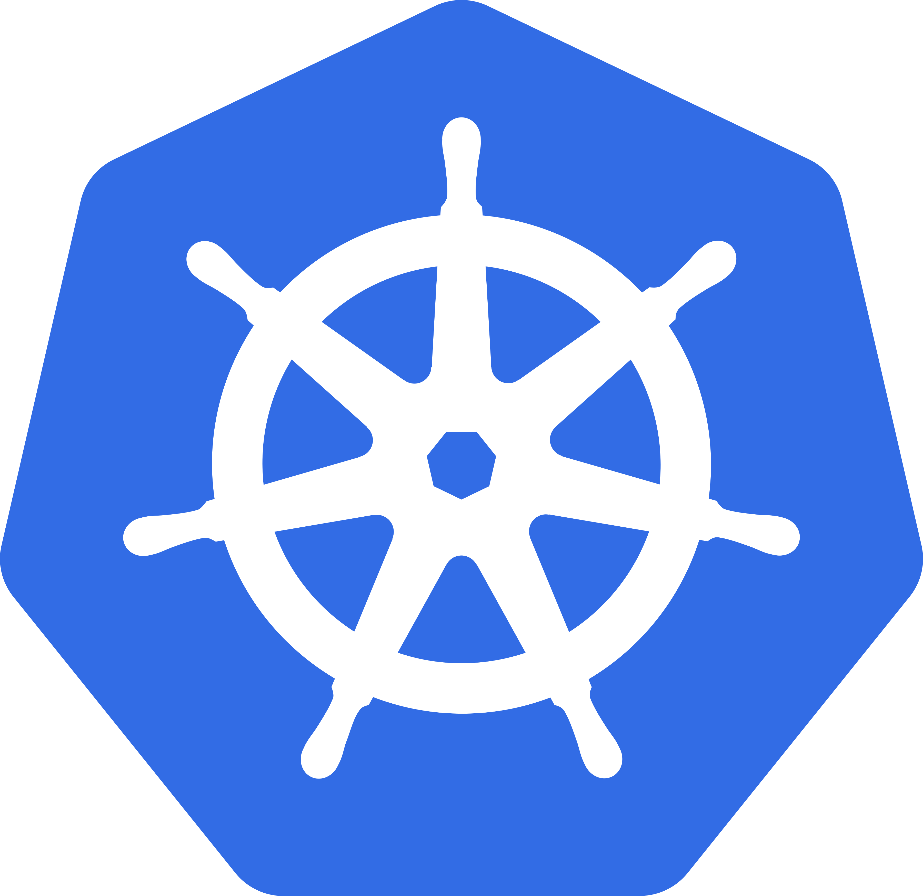




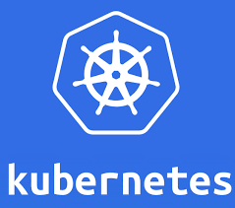


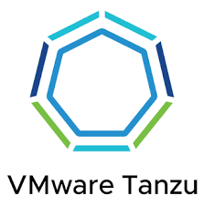
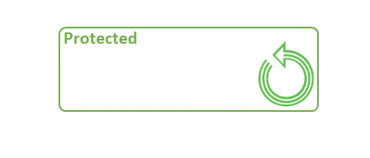













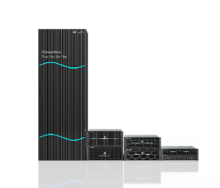
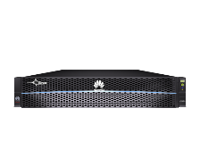
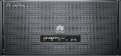
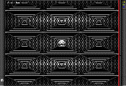
Storage Ecosystem: Trilio Backup and Recovery for Kubernetes on
Huawei OceanStor Dorado
RELIABLE
PERFORMANCE & VALUE
Certified for Huawei Storage
Intelligent Recovery
Multi-Cloud Solution
Data Protection +
Scale out Storage and Protection
Protect and store Cloud Native workloads in any OceanStor Dorado environment.
Exclusive Certified Primary Storage Vendor
Protect & Recover
CDR
Secure
Backup
Disaster Recovery
Ransomware Protection
99.9% ransomware detection accuracy
All CNCF Kubernetes Based Applications and Data
Encrypted
New workloads
Ransomware Recovery
Backup Rule Compliant: 3-2-1-1-0
Economical
Isolation
Space saving 56% ↓
1.09 W/TB, power consumption 6% ↓
Air Gap
Other clouds
Secure, Encrypted, Immutable
Production
OceanStor Dorado
All-Flash Storage
OceanStor Pacific Scale-Out Storage
OceanStor A Series
AI Data Lake Storage
OceanStor Pacific
Object Storage
Backup
Archive

